Slide 1
Notes:
PowerPoint Resource
This resource has been developed as an introductory teaching tool for the exhibition KAWS: Companionship in the Age of Loneliness. The notes and discussion prompts require adaptation to suit the level and needs of your class.
Learning Objectives:
Identify and discuss how key themes, concepts and ideas are expressed in KAWS's work.
Identify and explain important influences on KAWS’s choices in art making.
Explore how KAWS uses materials, techniques, technologies and processes to realise the intentions in his artworks.
Identify and connect specific features of KAWS's work to a wider social and commercial context.

Slide 2
Notes:
Introduction to KAWS
Brian Donnelly (born 1974), aka KAWS, is one of the most prominent and prolific artists of his generation. His body of work bridges the worlds of art, fashion and design to include paintings, murals, large-scale sculptures, street and public art, and fashion, graphic and product design. He was born in 1974 in New Jersey and started out as a graffiti and street artist. Now living and working in Brooklyn, New York, KAWS draws on the complexities of modern life and the contemporary built environment, and contrasts this with the aesthetics of pop and street culture.
Introduction to KAWS: Companionship in the Age of Loneliness
The exhibition KAWS: Companionship in the Age of Loneliness focuses on how emotions have been communicated through the artist’s work. Through his works KAWS celebrates generosity, support for others and the deep need we have for companionship and friendship. The exhibition divides KAWS work into sections that help us understand his work, approaches and ideas:
Early works of graffiti & advertising interventions
Pop culture & iconography
Sculpture: KAWS’s characters
Painting practice
Wider context: sculptures and collaborations

Slide 3
Notes:
KAWS starting out
KAWS grew up in Jersey City, New Jersey which was sleepy in comparison to the urban giant of Manhattan, directly across the Hudson River. The first graffiti artists that he became familiar with were those working locally, and his initial steps towards becoming an artist came through writing, or tagging, in his teens, with his tag ‘KAWS’ soon becoming prevalent in his Jersey City neighbourhood.
By the late 1980s, skateboarding regularly took KAWS to New York City. He worked across Jersey City and Manhattan on ambitiously scaled pieces as part of various graffiti crews. He also completed detailed pieces on walls and billboards, and on the sides of freight trains that moved across the country.
Discussion Prompts
A moniker is a name, kind of like a nickname. KAWS is the moniker Brian Donnelly uses as an artist. Who else can you think of who uses a moniker?
Donnelly chose the name KAWS because he liked the way the letters looked together. Look at the photo above of ‘KAWS’ spray-painted on the freight train and suggest what KAWS may have found interesting about the letters.
Search online for an example of street art that interests you. What do you find interesting about this and why?
How is street art different to art you would see in a gallery? How is it similar?

Slide 4
Notes:
Discussion Prompts
Describe what you see in these artworks. What aspects of these works and their presentation differ from historical artworks? For example, think about where they are presented and connections to advertising and popular culture.
Early Works: Public interventions
In 1996, KAWS began to work with the smaller-scale medium of advertising posters. Using a master key designed to open most advertising cabinets across New York, KAWS removed the posters from bus shelters and telephone booths and worked on them in his studio. In comparison to graffiti, which KAWS created urgently in public with the fear of being caught, he could now spend hours considering each brushstroke and perfecting the work in his own time. Once finished, he would place the advertisements back in the public sphere. This new medium and method of painting led to a more blurred line between what might be considered original and what is an intervention. His advertising interventions became so popular around the world that people would often remove them to take home as collector’s pieces.
The skull and crossbones
KAWS’s unique artistic language of pictorial interventions, symbols and figures cut through any language or cultural barriers. The skull and crossbones is a globally recognised symbol for death which originated in the Late Middle Ages as a Memento mori (reminder of mortality) on gravestones. This symbology of death in the form of the skull, as well as the blank Xs instead of eyes, pervades the works, but so too does a certain cuteness, introduced by the comic-like nature of the skull and the character BENDY.
Discussion Prompts
Look at the works illustrated. What has KAWS added to the advertisements? What do the additions to each work have in common?
What meaning or ideas do KAWS’s interventions add to the original advertisement? How does the original advertisement’s message change?
What do you think inspired KAWS to paint onto these particular advertisements?

Slide 5
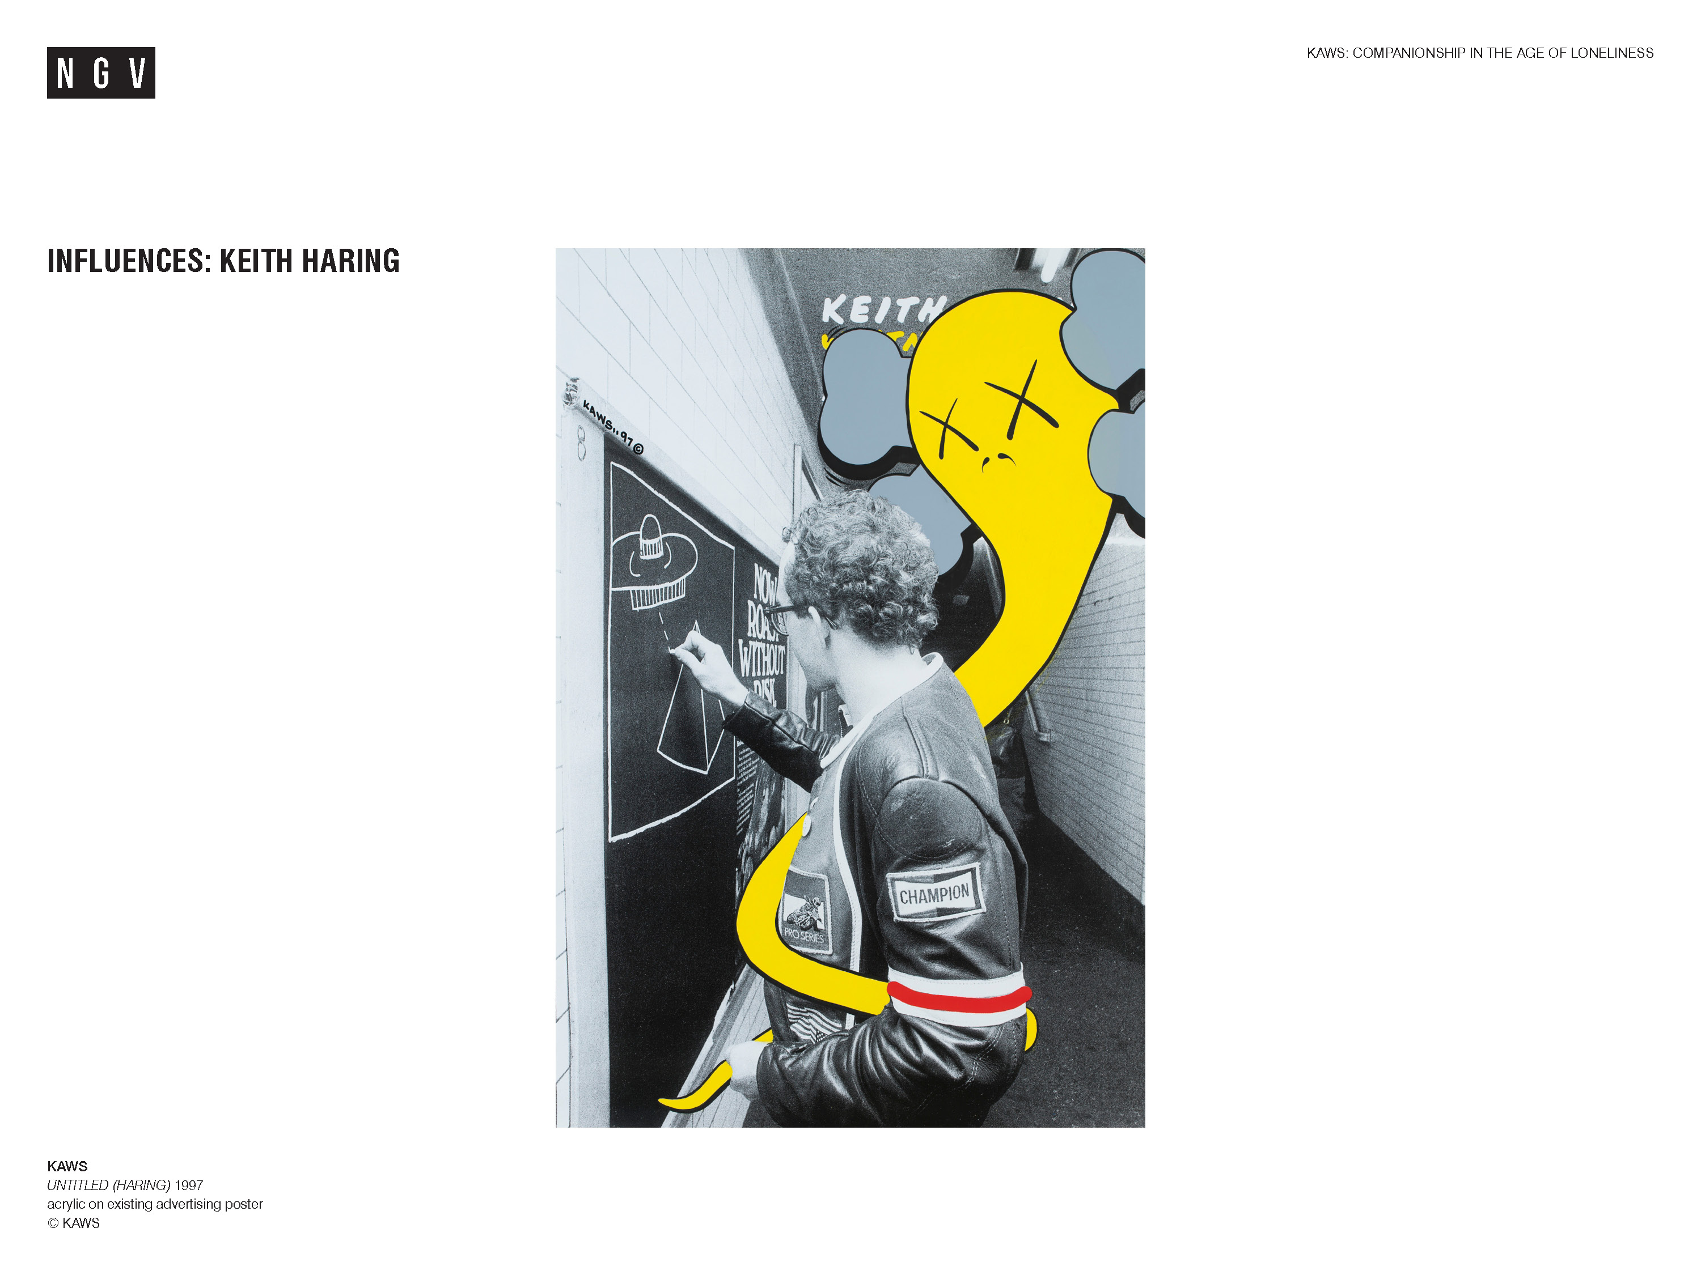
Notes:
Influences: Keith Haring
KAWS collects and champions artists who practise on the fringes of the art world. He takes inspiration from iconic subculture figures such as New York street-artist Keith Haring (1958-1990).
In 1997, in a gesture of homage or respect, KAWS painted on a poster of New York artist Keith Haring. In this work, KAWS depicts his character BENDY wrapped around Haring as he is drawing one of the 5000 chalk drawings Haring is estimated to have completed in public spaces. The popularity of Haring’s work exploded during the early 1980s, to the point where people were removing his subway works almost immediately after they were completed. This is similar to KAWS’s own experience with his advertising-poster interventions. Haring’s work in the public – outside the museum and gallery context – and his efforts to democratise art left a strong impression on KAWS.
Discussion Prompts
Consider what is going on in the image. What may have interested KAWS about this image of Keith Haring?
How does the work on the slide above differ from KAWS’s advertising interventions?
What meanings and ideas do you think KAWS is communicating in this work?
Look Keith Haring’s work and art practice, and suggest what KAWS may have admired about this artist.

Slide 6
Notes:
Discussion Prompts
What do you recognise about these works? What is surprising or unexpected about the images?
Look at both images. What do they have in common? Consider the subject matter, style and use of visual elements.
Popular Culture & Appropriation
Artists often use appropriation to highlight or subvert the meanings and values associated with the original image. In these works, KAWS has adopted the artistic strategy of appropriation as he did in his advertising interventions. He uses characters from comic strips and animated TV series such as the famous American family from the popular TV show The Simpsons. KAWS’s painting technique is so precise that the images are almost indistinguishable from the original animation. He makes the famous cartoon characters his own by replacing their heads with a skull-and-crossbones face, and changing their eyes to Xs, stripping the characters of their sight and personality.
The Simpsons is unparalleled in the way it picks apart modern life through its absurdist and nihilistic nature. It is underpinned by a functional family unit that, while often in conflict, is ultimately held together through mutual love and support for one another within a largely dysfunctional world. The series may have had underlying resonance for KAWS due to its widespread influence on American culture in the 1990s and 2000s.
Discussion Prompts
Why do you think KAWS has chosen to appropriate imagery such as the Simpsons and Spongebob?
How does KAWS’s treatment of the characters add to or change the meaning of the original cartoon? What do you see in the work which makes you think this?
What emotions or feelings are expressed through these works and how? Consider the role of gesture, expression, body language and colour.
How might these works be seen as representing the deep need we have for companionship and friendship?

Slide 7
Notes:
Discussion Prompt
What aspects of each of the above sculptures look familiar to you and why?
What emotions are captured with each of the sculptural characters in the slide? How is that emotion communicated through the work?
Sculpture: KAWS’s characters
KAWS’s sculptures draw on elements from iconic cartoon and pop-culture characters and have universal appeal. His sculptural work consists of a universe of characters including COMPANION, ACCOMPLICE, BFF and CHUM. He began making these as toys in the late 1990s after discovering a thriving collectables community in Japan. Since its introduction in 1999, COMPANION has been created in a wide range of different colourways and scales ranging from human size to monumental sculptures.
Companionship in the Age of Loneliness
In recent years, KAWS’s sculptures have become more emotional and empathic. The characters often appear sad, fragile, humble and vulnerable. The COMPANION in COMPANION (PASSING THROUGH), 2011, covers its face with its hands as if inconsolably crying. The sculptures resonate with contemporary issues such as loneliness, the lack of human contact in today’s society, and helplessness in the face of dark times. COMPANION sculptures also suggest companionship as an antidote to these overwhelming feelings, such as in TOGETHER, 2017, where a second COMPANION embraces the other.
Discussion Prompt
Look at the titles of the works on the slide. What is the similarity between them? What feelings do the titles suggest?
What do you think KAWS is trying to say with these sculptures? Consider the names of the characters, their poses, and the symbolism of the skull and crossbones motif.
Why do you think KAWS produces the characters in such a wide range of sizes? How does size, scale and colour affect the meaning of the sculpture?

Slide 8
Notes:
Discussion prompts
Create a list of descriptive words to describe the colours, shapes and lines in these works.
How are these works different from KAWS’s previous work?
How do these works make you feel? What is it about the work that evokes these feelings?
Painting materials and method
KAWS uses acrylic paint using a defined palette to ensure consistency and the cel animation technique of painting by numbers. He became familiar with these materials and methodologies while working at the animation studio Jumbo Pictures, painting for series such as Disney’s 101 Dalmatians and cult MTV show Daria.
Recent Painting Practice
KAWS has experimented with abstraction and fragmentation in his paintings, incorporating a range of figures such as KAWSBOB, CHUM and the KIMPSONS as his subjects. Created across square and round canvases, the KAWSBOB paintings crop into the character’s facial features more and more until its expressions become increasingly anxious and distorted. Examples can be seen in the multi-panel and tondo (circular) paintings KAWS produced between 2010 and 2014, such as UNTITLED, 2013, (pictured).
KAWS’s recent painting practice has further embraced abstraction, including multi-coloured and multilayered camouflage-like patterning. This patterning is reminiscent of Andy Warhol’s use of coloured camouflage in his works such as SELF-PORTRAIT NO.9, 1986 (in the NGV Collection, on display on Level 2).
NEW FICTION, 2018, features new elements such as abstractions of landscapes and an extended colour palette which includes rich earthy tones. Some elements from his early practice appear throughout as a running thread such as the signature Xs.
Discussion prompts
Which themes from KAWS’s earlier work can be seen in his more recent art practice? What evidence can you find in the works to support your answer?
What meanings or ideas are suggested by the abstraction and fragmentation in KAWS’s recent paintings?

Slide 9
Notes:
Sculptures and collaborations
As well as engaging an audience in the museum and gallery context, KAWS’s works in the public and digital space also has a wide reach. His work in the public space includes monumental inflatable sculptures, first created for the 2012 Macy’s Thanksgiving Day Parade in Manhattan and then the MTV Video Music Awards in 2013. In 2018, in collaboration with creative studio AllRightsReserved, KAWS created KAWS:HOLIDAY, a 28-metre-long inflatable COMPANION that floated on Seokchon Lake in Seoul. Since then, similar large-scale COMPANION installations have been displayed in Taipei, Hong Kong Harbour, Virginia Beach in the US, and Mount Fuji in Japan.
GONE, 2019
The NGV Commission, GONE, 2019, is the largest bronze sculpture KAWS has created to date. The large-scale work is an emotional depiction of loss. The pose is similar to the famous Renaissance sculpture by Michelangelo, PIETÀ, 1498–99, which depicts the biblical figure of the Virgin Mary cradling the body of her Christ, her son, after his crucifixion. For the exhibition GONE is on display in Federation Court, the main entrance to NGV International.
Discussion Prompts
What do you think these works are about? What do you notice about the works which leads you to think this?
What do these works reveal about how KAWS uses scale and location to connect with a wide audience?
Compare GONE to Michelangelo's PIETÀ 1498-99. What do these works have in common in the emotions they communicate, and how the emotions are communicated? How are they different?

